Slide 1
2 Graphical User Interfaces (cont.)
BK Chap. 11.

Slide 2
Overview
GUI layout
Nested containers
Borders
Spacing
Dialogues
ImageViewer ver. 2.0, 3.0, 3.05, 3.1

Slide 3
Layout managers
Manage limited space for competing components.
  FlowLayout, BorderLayout, GridLayout, BoxLayout, GridBagLayout.
Manage Container objects, e.g. a content pane.
Each imposes its own style.
Notes:
AWT-klasser

Slide 4

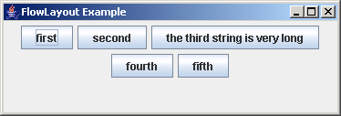
FlowLayout
Notes:
Demo: projekt layouts
Komponenterna behåller sin storlek vid omskalning
Wrap-around
Aligning
FlowLayout.LEFT
FlowLayout.RIGH
FlowLayout.CENTER
FlowLayout.LEADING *
FlowLayout.TRAILING *
Orientation * (behållarens orientering bestämmer)
ComponentOrientation.LEFT_TO_RIGHT
ComponentOrientation.RIGHT_TO_LEFT
contentPane.setComponentOrientation(-=-);

Slide 5
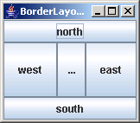
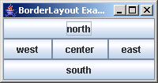
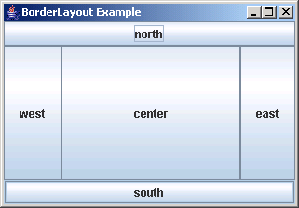
BorderLayout
Notes:
Kan vara färre än fem paneler
Dema hur sidopanelerna skalas om
vid omskalning av fönstret

Slide 6
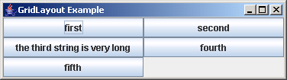
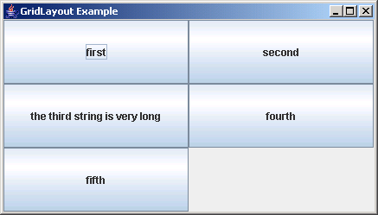
GridLayout
Notes:
Alla för samma storlek

Slide 7
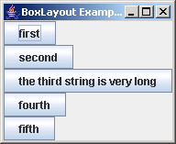
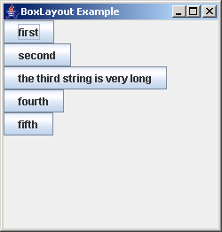
BoxLayout
Note: no component
resizing.
Notes:
Detta är en Swing-klass!
Ingen wrap-around
// BoxLayout.X_AXIS
// BoxLayout.Y_AXIS
// BoxLayout.LINE_AXIS
// BoxLayout.PAGE_AXIS

Slide 8
Nested containers
Sophisticated layouts can be obtained by nesting containers.
  Use JPanel as a basic container.
Each container will have its own layout manager.

Slide 9
AWT Components and Containers
Components have graphical representation
Containers have components
Containers are components
Component
…
Button
Label
Checkbox
Container
Notes:
AWT-hierarki
OBS Button m.fl. är ej Swing-komponenter

Slide 10
Swing Components and Containers
Use JPanel as container for Swing components
Component
Container
JComponent
JPanel
Notes:
JPanel är en lättvikstbehållare
JComponent-klasser måste finnas i en hierarki som rotas med en toppnivå-Swingbehållare, t.ex. JFrame

Slide 11
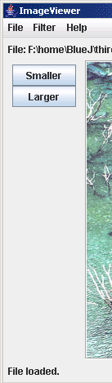
Buttons and nested layouts
A GridLayout inside
a FlowLayout inside
a BorderLayout.

Slide 12
Borders
Used to add decoration around components.
Defined in javax.swing.border
  BevelBorder, CompoundBorder, EmptyBorder, EtchedBorder, TitledBorder.

Slide 13
Adding spacing
JPanel contentPane = (JPanel)frame.getContentPane();
contentPane.setBorder(new EmptyBorder(6, 6, 6, 6));
// Specify the layout manager with nice spacing
contentPane.setLayout(new BorderLayout(6, 6));
imagePanel = new ImagePanel();
imagePanel.setBorder(new EtchedBorder());
contentPane.add(imagePanel, BorderLayout.CENTER);

Slide 14
Struts and Glue
Invisible components used as spacing.
Available from the Box class.
Strut: fixed size.
  Component createHorizontalStrut(int width)
  Component createVerticalStrut(int height)
Glue: fills available space.
  Component createHorizontalGlue()
  Component createVerticalGlue()

Slide 15
Other components
Slider
Spinner
Tabbed pane
Scroll pane
Notes:
Slider skjutreglage
Spinner Liten textruta (rad) med upp/ner-
pilar
Tabbed pane flikar
Scroll pane rullist (kan t.ex. hakas på
en textarea)

Slide 16
Dialogs
Modal dialogs block all other interaction.
  Forces a response from the user.
Non-modal dialogs allow other interaction.
  This is sometimes desirable.
  May be difficult to avoid inconsistencies.

Slide 17
JOptionPane standard dialogs
Message dialog
  Message text plus an OK button.
Confirm dialog
  Yes, No, Cancel options.
Input dialog
  Message text and an input field.
Variations are possible.
Notes:
Demo: Dialogtest
(man får lyfta fram dialogen
- Kolla sen i konsolfönstret)

Slide 18
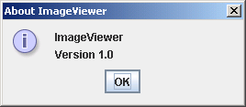
A message dialog
private void showAbout()
{
JOptionPane.showMessageDialog(frame,
"ImageViewer\n" + VERSION,
"About ImageViewer",
JOptionPane.INFORMATION_MESSAGE);
}

Slide 19
Image filters
Functions applied to the whole image.
int height = getHeight();
int width = getWidth();
for(int y = 0; y < height; y++) {
for(int x = 0; x < width; x++) {
Color pixel = getPixel(x, y);
alter the pixel's color value;
setPixel(x, y, pixel);
}
}

Slide 20
Adding further filters
private void makeLighter()
{
if(currentImage != null) {
currentImage.lighter();
frame.repaint();
showStatus("Applied: lighter");
}
else {
showStatus("No image loaded.");
}
}
Code duplication?
Refactor!
private void threshold()
{
if(currentImage != null) {
currentImage.threshold();
frame.repaint();
showStatus("Applied: threshold");
}
else {
showStatus("No image loaded.");
}
}

Slide 21
Adding further filters
Define a Filter superclass (abstract).
Create function-specific subclasses.
Create a collection of subclass instances in ImageViewer.
Define a generic applyFilter method.
See imageviewer2-0.
Notes:
Visa ver. 1 igen
Kritisera strukturen
(det finns annoterad pappersversion
för v.1 och v.2)

Slide 22
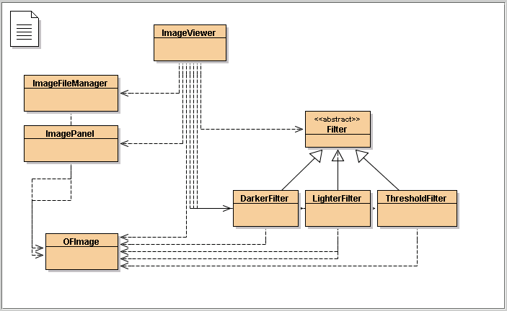
imageviewer2-0
Notes:
Koden för v.2 nu

Slide 23
Review
Aim for cohesive application structures.
  Endeavor to keep GUI elements separate from application functionality.
Pre-defined components simplify creation of sophisticated GUIs.
Layout managers handle component juxtaposition.
  Nest containers for further control.

Slide 24
Review
Many components recognize user interactions with them.
Reactive components deliver events to listeners.
Anonymous inner classes are commonly used to implement listeners.

